Slide 1
Cohort Builder

Slide 2
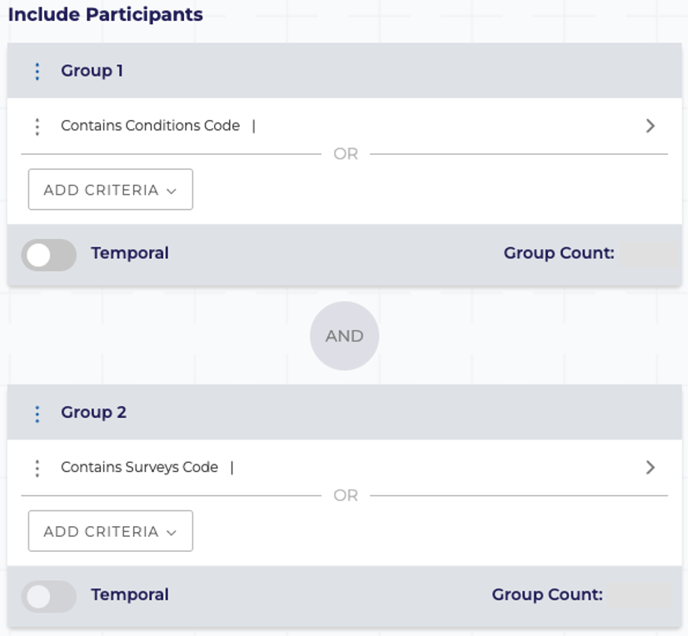
Subset your study population from all participants based on specified criteria using AND/OR operators
Demographics, conditions, measurements, medications, procedures, and surveys
Easily select inclusion and exclusion criteria
Add temporal events
Illness occurs N days before medication was prescribed
Accessing
Data
Cohort builder
Example criteria:
Race -> White, Black, Asian
Gender -> Men and Woman
Age -> 25 to 50 years ole
Condition - Diagnosed with/without Diabetes
Survey –PTSD medications and PTSD medical provider

Slide 3
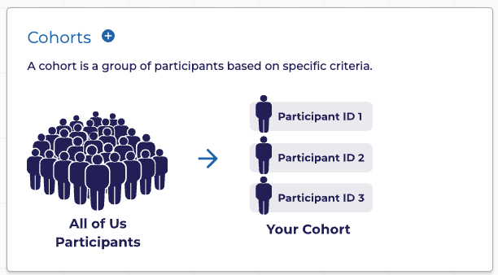
Diabetes_study_group

Slide 4
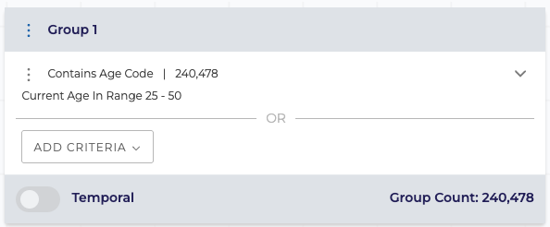
Diabetes_study_group: INCLUDE
Age at Consent: Participant's age when they first enrolled in the All of Us program.
Current Age & Age at CDR Date : Participant's age as of the latest data release cutoff date.
Current Age because it is the most concise and intuitive term.
choose Age at CDR Date to directly reference the technical name associated with the OMOP Common Data Model and the versioning metadata.

Slide 5
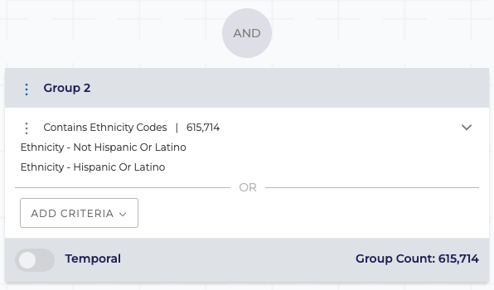
Diabetes_study_group: INCLUDE
The temporal toggle lets you set up a time-based constraint between two separate criteria you have already defined (Criteria 1 and Criteria 2).
Example: If you want a cohort of participants who were diagnosed with Hypertension 30 days after they started taking a new blood pressure medication

Slide 6
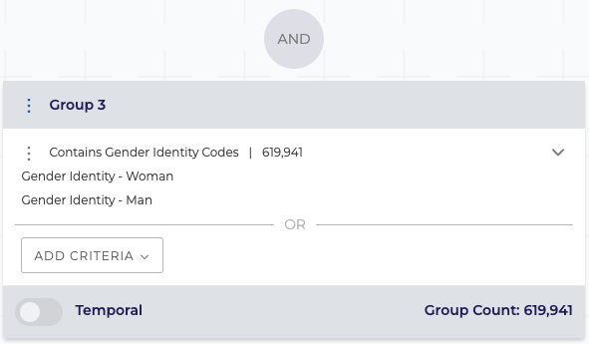
Diabetes_study_group: INCLUDE

Slide 7
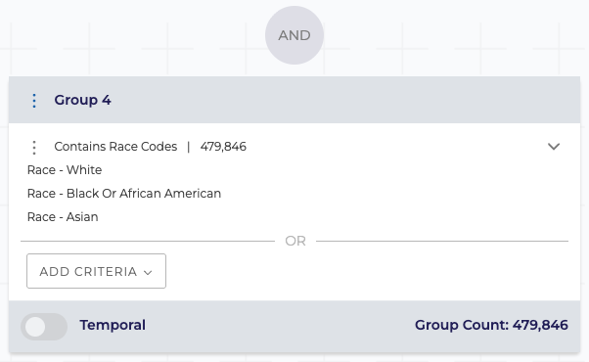
Diabetes_study_group: INCLUDE

Slide 8
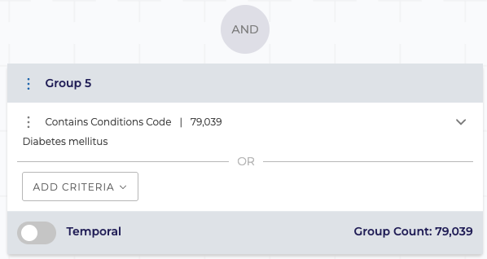
Diabetes_study_group: INCLUDE

Slide 9
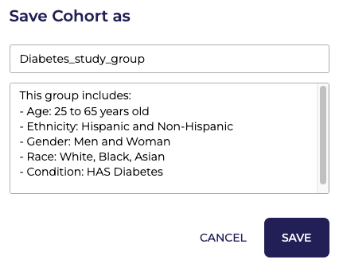

Diabetes_study_group: INCLUDE
2
1
Notes:
This group includes:
- Age: 25 to 65 years old
- Ethnicity: Hispanic and Non-Hispanic
- Gender: Men and Women
- Race: White, Black, Asian
- Condition: HAS Diabetes

Slide 10
Diabetes_control_group

Slide 11
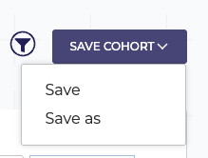
Open previous cohort
Delete Diabetes from Group 5
Add Diabetes to Exclusion
Save as: Diabetes_control_group
Notes:
This group includes:
- Age: 25 to 65 years old
- Ethnicity: Hispanic and Non-Hispanic
- Gender: Men and Women
- Race: White, Black, Asian
- Condition: NO Diabetes

Slide 12
Cohort Review

Slide 13
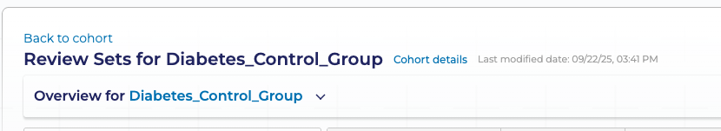
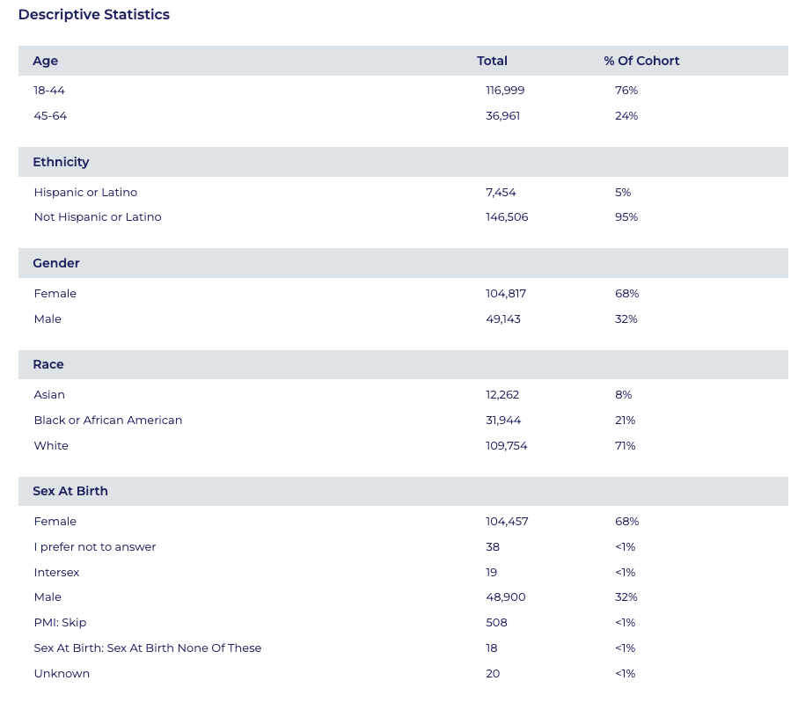
Choose cohort details to see descriptive statistics of your cohort

Slide 14
Dataset Builder

Slide 15
Dataset #1: Diabetes_study_group

Slide 16
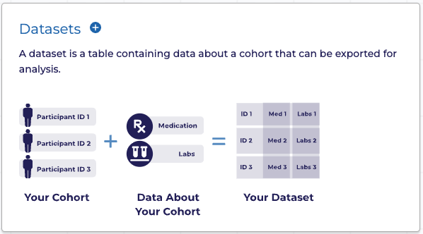
Step 0: select Datasets

Slide 17
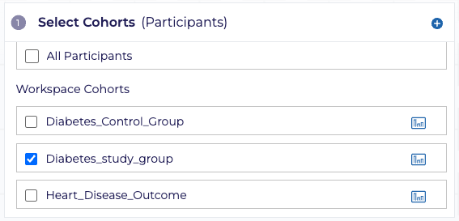
Step 1: select cohort Diabetes_study_group

Slide 18
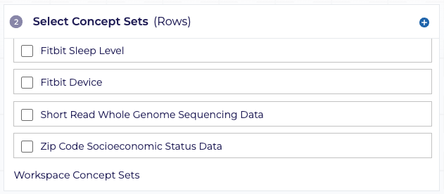
Step 2: create concept set survey concept set

Slide 19
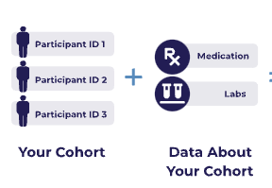
Variables to include in your analysis
Describe information from medical record
Demographics, conditions, prescription, physical measurements, etc.
Organized into concept domains which are the subject areas for each concept
Accessing
Data
Domain | Description
Conditions | Listed by ICD9 or ICD10 or SNOMED standard codes.
Procedures | Listed by ICD9, ICD10, CPT, or SNOMED standard codes.
Drugs or Medications | Listed by ingredient and organized by therapeutic uses.
Measurements | Laboratory tests and vital signs, organized in the LOINC code hierarchy.
Visits | Type of facility where medical care was received (ED, OP, IP).
Surveys | Questions and associated response options for participant-completed surveys.
Physical Measurements | At time of participant enrollment: BP, HR, height, weight, BMI, pregnancy, etc.
Demographics | Age, gender, race, ethnicity, and deceased status.
Concepts

Slide 20
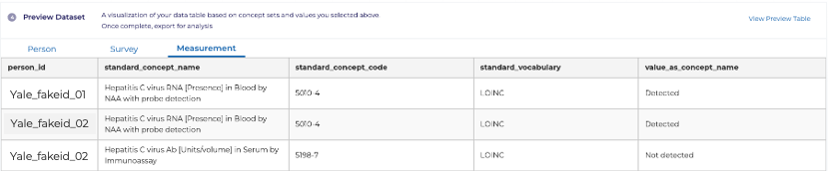
Concept sets are one or more concepts from a particular domain used to create the dataset for your analysis
The values from each concept set becomes its own table under the domain name in the analysis phase
Remember to include the same concepts from your cohort builder
After choosing your concept sets, select which values (columns) you’d like to keep
Measurements
(Domain)
HCV RNA
(Concept)
HBV surface antigen
(Concept)
HIV Ab
(Concept)
HCV, HBV, HIV labs
(“Measurement” Concept Set)
Accessing
Data
Concepts

Slide 21
Concept Hierarchy for Condition “Atrial fibrillation”
Heart disease
Acute heart disease
Athlete's heart
Cardiac arrhythmia
Cardiac arrest
Supraventricular arrythmia
Atrial fibrillation
Etc.
Etc.
Etc.
General:
a larger pool of patients
Specific:
smaller pool of patients

Slide 22
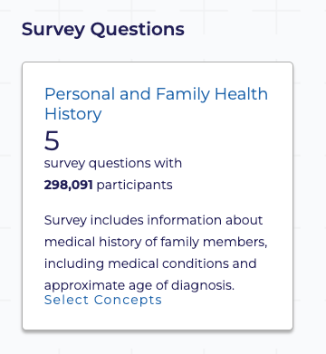
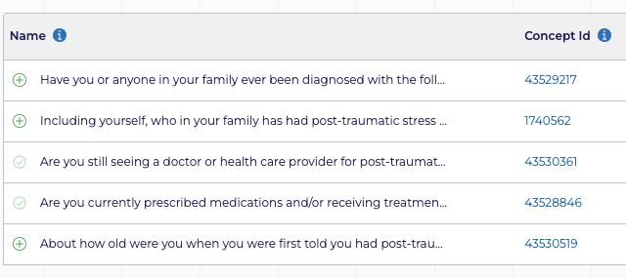
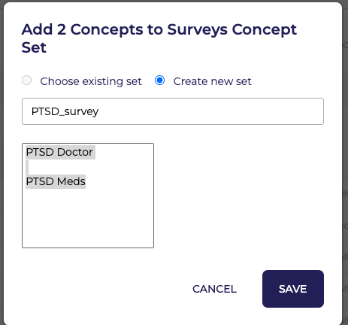
Step 2: create concept set survey concept set
1
2
3
4
Notes:
PTSD_survey
- PTSD Doctor
- PTSD Meds

Slide 23
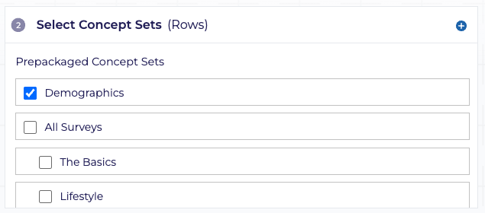
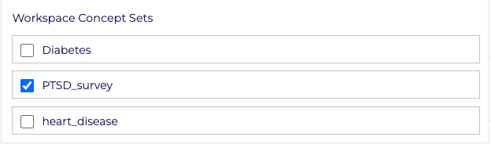
Step 2: select concept set Demographics and PTSD_survey

Slide 24
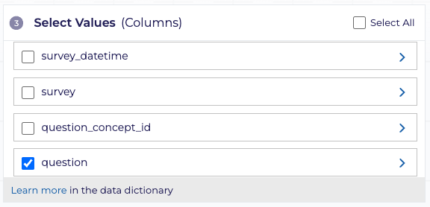
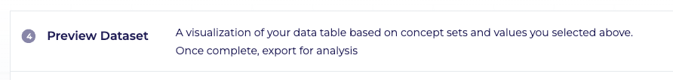
Step 3 and 4: select values and Preview Table!
Then Save! Diabetes_study_dataset

Slide 25
Dataset #2: Diabetes_control_group

Slide 26
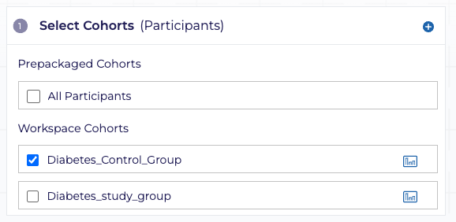
Step 1: select cohort Diabetes_study_group

Slide 27
Step 2: select concept set Demographics and PTSD_survey

Slide 28
Step 3 and 4: select values and Preview Table!
Then Save! Diabetes_control_dataset

Slide 29
Analyze

